Slide 1

Supplier Name: - Durga Industory D-38
Supplier Audit Report
Auditor:- Vijay Kushwaha, Dushyant
Audit Date:-09.01.2021
Auditee: -Mr. Parveen Ji ,Gajendra
S.No
Audit
Head
Issue
Observed / Suggestion
Before Photo
Action plan
After Photo
Resp./
Tgt. Date
Quality Policy /Company’s Objectives not display
1
Organization
No Data Found
-
-
Durga Industory D-38
12.01.2021
Management Review on period basis the quality / supply related issues record is not available
2
Organization
No Data Found
-
-
Durga Industory D-38
12.01.2021
Documents & Drawings
Control Plan not available & Uncontrolled Drawing available
3
No Data Found
-
-
Durga Industory D-38
12.01.2021
PREPARED BY:-VIJAY KUSHWAHA
APPROVED BY:-KUMAR SAURABH

Slide 2
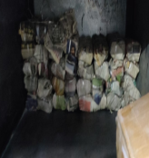
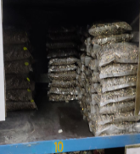
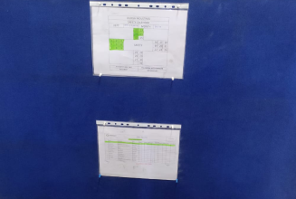
Supplier Name: - Durga Industory D-38
Supplier Audit Report
Auditor:- Vijay Kushwaha, Dushyant
Audit Date:-09.01.2021
Auditee: -Mr. Parveen Ji ,Gajendra
S.No
Audit
Head
Issue
Observed / Suggestion
Before Photo
Action plan
After Photo
Resp./
Tgt. Date
4
Incoming Quality Control
MTC not available
No Data Found
-
-
Durga Industory D-38
12.01.2021
Incoming Quality Control
CAPA Report not available
Durga Industory D-38
12.01.2021
5
No Data Found
-
-
6
Storage & Handling
FIFO not maintained of Raw /BOP
-
-
Durga Industory D-38
12.01.2021
PREPARED BY:-VIJAY KUSHWAHA
APPROVED BY:-KUMAR SAURABH

Slide 3
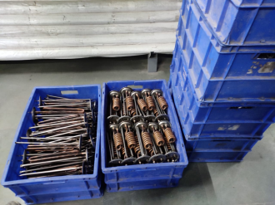
Supplier Name: - Durga Industory D-38
Supplier Audit Report
Auditor:- Vijay Kushwaha, Dushyant
Audit Date:-09.01.2021
Auditee: -Mr. Parveen Ji ,Gajendra
S.No
Audit
Head
Issue
Observed / Suggestion
Before Photo
Action plan
After Photo
Resp./
Tgt. Date
7
Storage & Handling
FG Area not identified
-
-
Durga Industory D-38
12.01.2021
8
Storage & Handling
Scrap & Waste material not identified & Traceable
No Data Found
-
-
Durga Industory D-38
12.01.2021
9
Process Controls
First Part inspection is not done & display
Durga Industory D-38
12.01.2021
No Data Found
-
-
PREPARED BY:-VIJAY KUSHWAHA
APPROVED BY:-KUMAR SAURABH

Slide 4
Supplier Name: - Durga Industory D-38
Supplier Audit Report
Auditor:- Vijay Kushwaha, Dushyant
Audit Date:-09.01.2021
Auditee: -Mr. Parveen Ji ,Gajendra
S.No
Audit
Head
Issue
Observed / Suggestion
Before Photo
Action plan
After Photo
Resp./
Tgt. Date
No Training plan available & only Skill matrix available but not Implemented
10
Training
No Data Found
-
-
Durga Industory D-38
12.01.2021
Training
OJT records for critical operations not available.
Durga Industory D-38
12.01.2021
11
No Data Found
-
-
12
PDI control
Limit sample not available
Durga Industory D-38
12.01.2021
No Data Found
-
-
PREPARED BY:-VIJAY KUSHWAHA
APPROVED BY:-KUMAR SAURABH

Slide 5
Supplier Name: - Durga Industory D-38
Supplier Audit Report
Auditor:- Vijay Kushwaha, Dushyant
Audit Date:-09.01.2021
Auditee: -Mr. Parveen Ji ,Gajendra
S.No
Audit
Head
Issue
Observed / Suggestion
Before Photo
Action plan
After Photo
Resp./
Tgt. Date
Sop & important check point not display
No Data Found
13
PDI Control
-
-
Durga Industory D-38
12.01.2021
PDI report not maintained & not submitted to Onkar D-316 with every lot
14
PDI Control
No Data Found
-
-
Durga Industory D-38
12.01.2021
15
CAPA
Internal & External CAPA not available
Durga Industory D-38
12.01.2021
No Data Found
-
-
PREPARED BY:-VIJAY KUSHWAHA
APPROVED BY:-KUMAR SAURABH

Slide 6
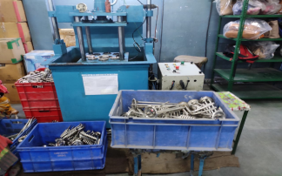
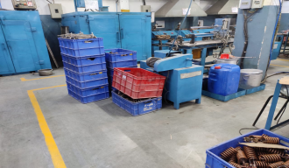
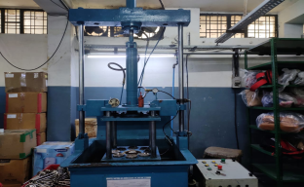
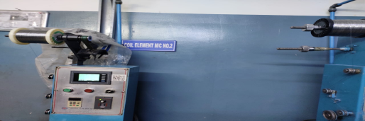
Supplier Name: - Durga Industory D-38
Supplier Audit Report
Auditor:- Vijay Kushwaha, Dushyant
Audit Date:-09.01.2021
Auditee: -Mr. Parveen Ji ,Gajendra
S.No
Audit
Head
Issue
Observed / Suggestion
Before Photo
Action plan
After Photo
Resp./
Tgt. Date
Customer Rejection not monitored on monthly basis
16
CAPA
No Data Found
-
-
Durga Industory D-38
12.01.2021
17
Non Conforming Report
Hold & Rework Material not Identified
-
-
Durga Industory D-38
12.01.2021
Non Conforming Report
Work Instruction & Process Verification sheet are not display near the machine
18
-
-
Durga Industory D-38
12.01.2021
PREPARED BY:-VIJAY KUSHWAHA
APPROVED BY:-KUMAR SAURABH

Slide 7
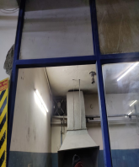
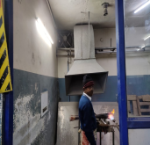
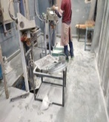
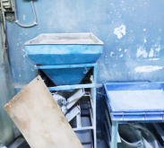
Supplier Name: - Durga Industory D-38
Supplier Audit Report
Auditor:- Vijay Kushwaha, Dushyant
Audit Date:-09.01.2021
Auditee: -Mr. Parveen Ji ,Gajendra
S.No
Audit
Head
Issue
Observed / Suggestion
Before Photo
Action plan
After Photo
Resp./
Tgt. Date
19
Process Control
Machine No. & Name not identification & Area are not defined.
Durga Industory D-38
12.01.2021
-
-
PREPARED BY:-VIJAY KUSHWAHA
APPROVED BY:-KUMAR SAURABH

